Slide 1
Clinical Results & Business Integration
Stuart Mohr, VP Marketing & Clinical

Slide 2
p=0.01
p=0.09
No 3rd Laser Tx

Slide 5
Value of Pretreating: JMSR + BBL vs. BBL Alone

Slide 6
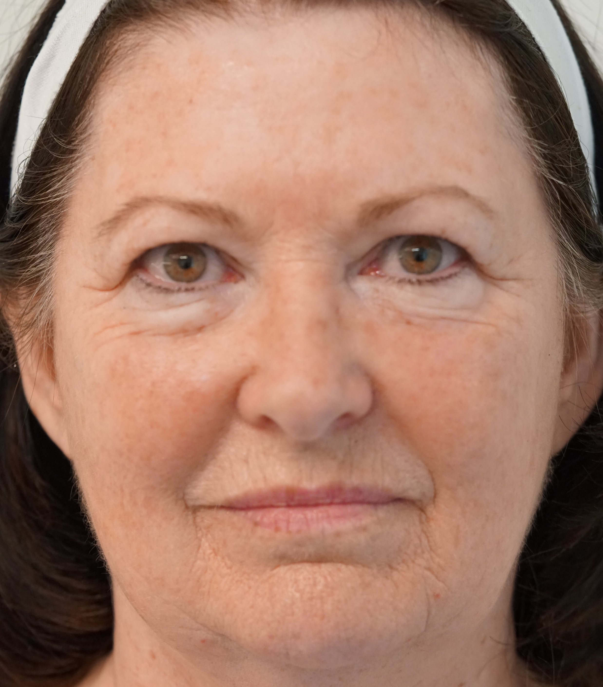

Slide 7
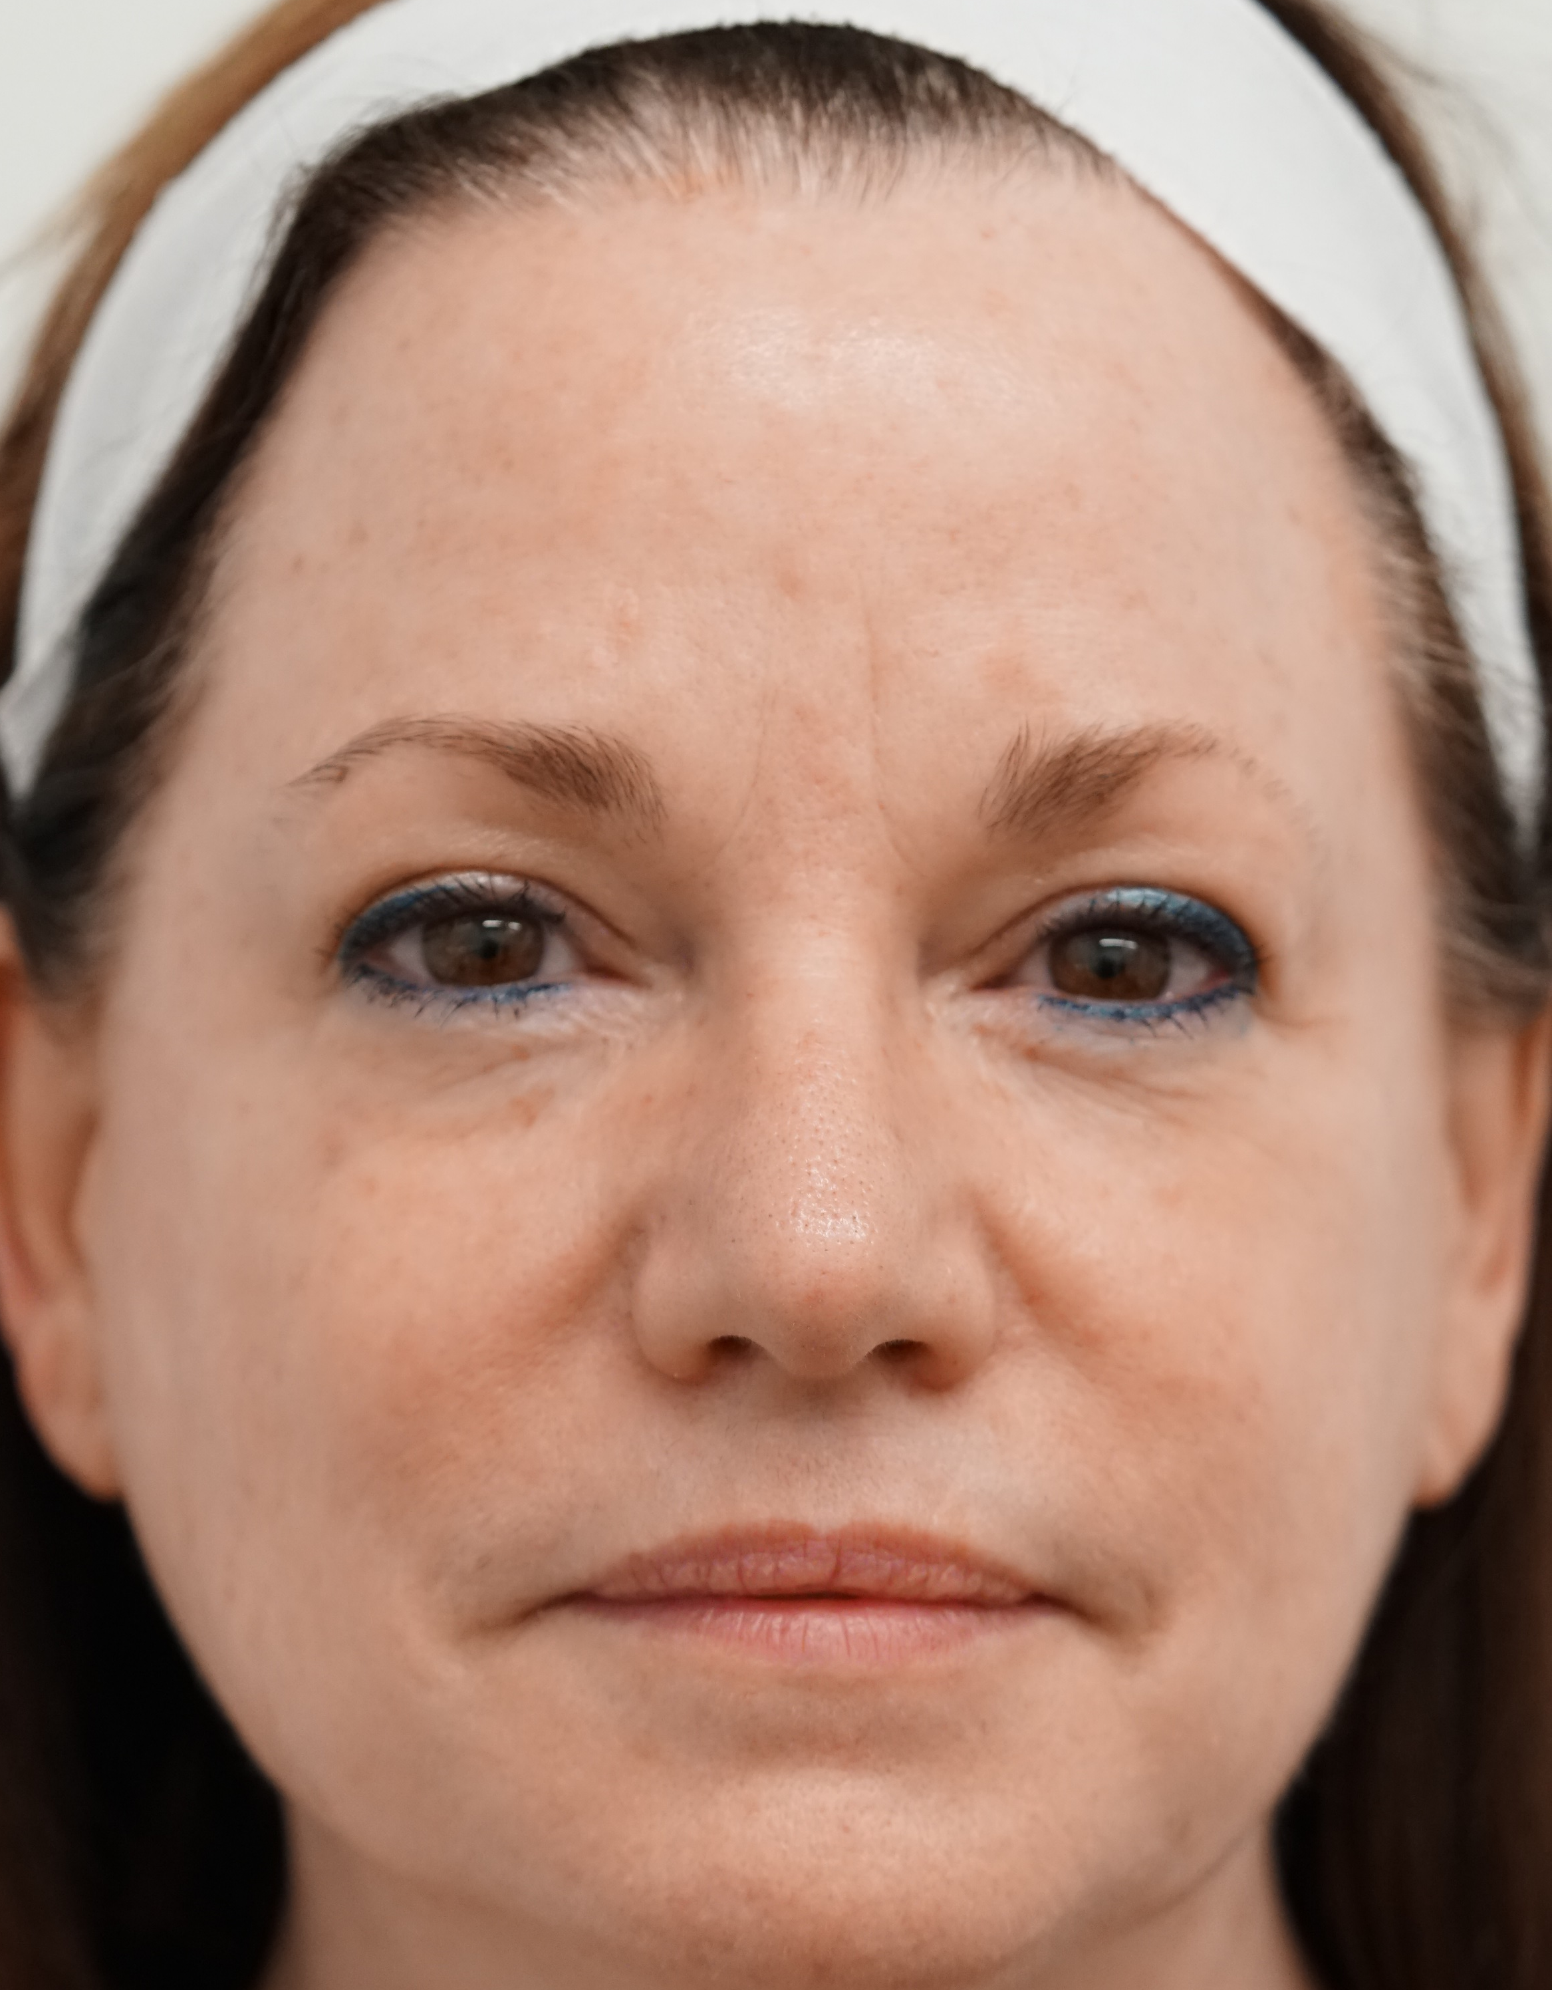

Slide 8
Increased Office Profitability
BBL (only)
BBL = $400-500 / 45-minute room
Cost = $250-$350
Staff, device, overhead, etc.
Profit = $200 * 3-5 Tx = $800
Adding skincare
Skincare = $400 (SCMS MD)
Cost = $200
No added time – part of service
Profit = $200 * 4-5 per year = $900
Adding JMSR to Office Services
Increases results
Increases patient satisfaction
Extends Results
Doubles profit per room-hour
Leads to greater referral growth

